Slide 1
Group | Healthy Control | Protential Convert | Convert | Affect
Sample size | 59 | 10 | 33 | 35
Female,n(%) | 32 (54.2%) | 4 (40%) | 20 (60.6%) | 15 (42.9%)
Age(yr),mean(sd) | 51.34 (12.39) | 49.12 (8.85) | 57.22 (10.10) | 56.78 (9.37)
Genotype
SOD1 A4V |  | 4 | 15 | 1
SOD1 nonA4V |  | 4 | 8 | 2
C9orf72 |  | 2 | 7 | 6
Other Genotype |  |  | 3 | 26
Unknown | 59
Visits
1 | 21 | 0 | 0 | 0
2 | 11 | 1 | 6 | 2
3 | 25 | 1 | 3 | 25
>=4 | 2 | 8 | 24 | 8
Total number of Visit | 126 | 62 | 202 | 126
Average visit per person | 2.1 | 6.2 | 6.1 | 3.6
Table 1 The Sample info
a)

Slide 2
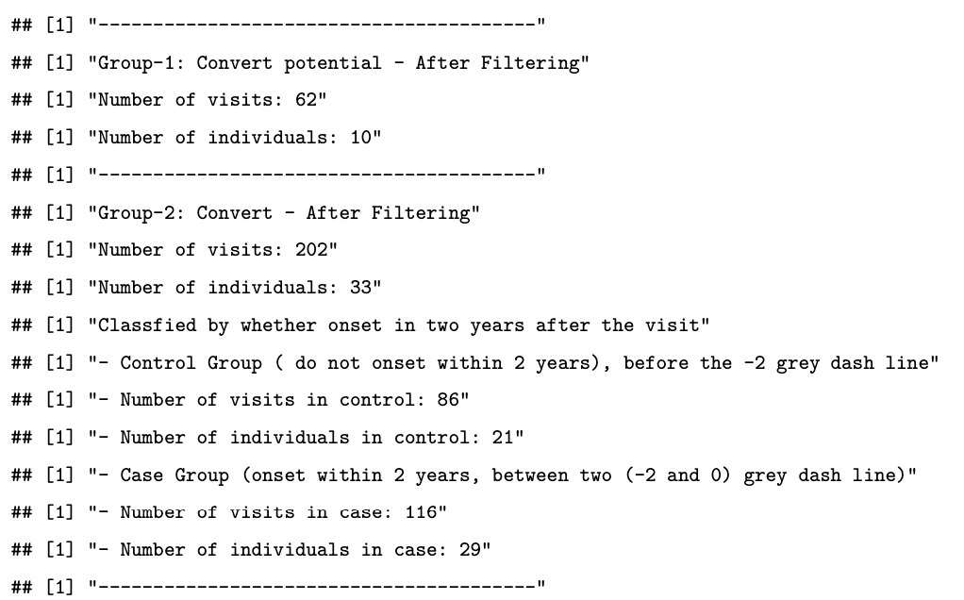
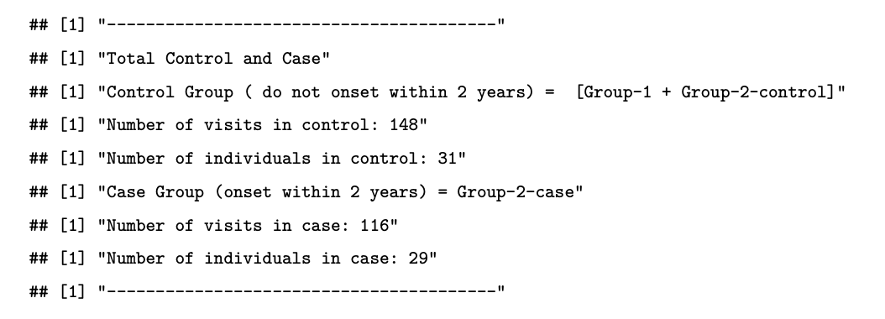
Table 2 The data description in Classification model

Slide 3
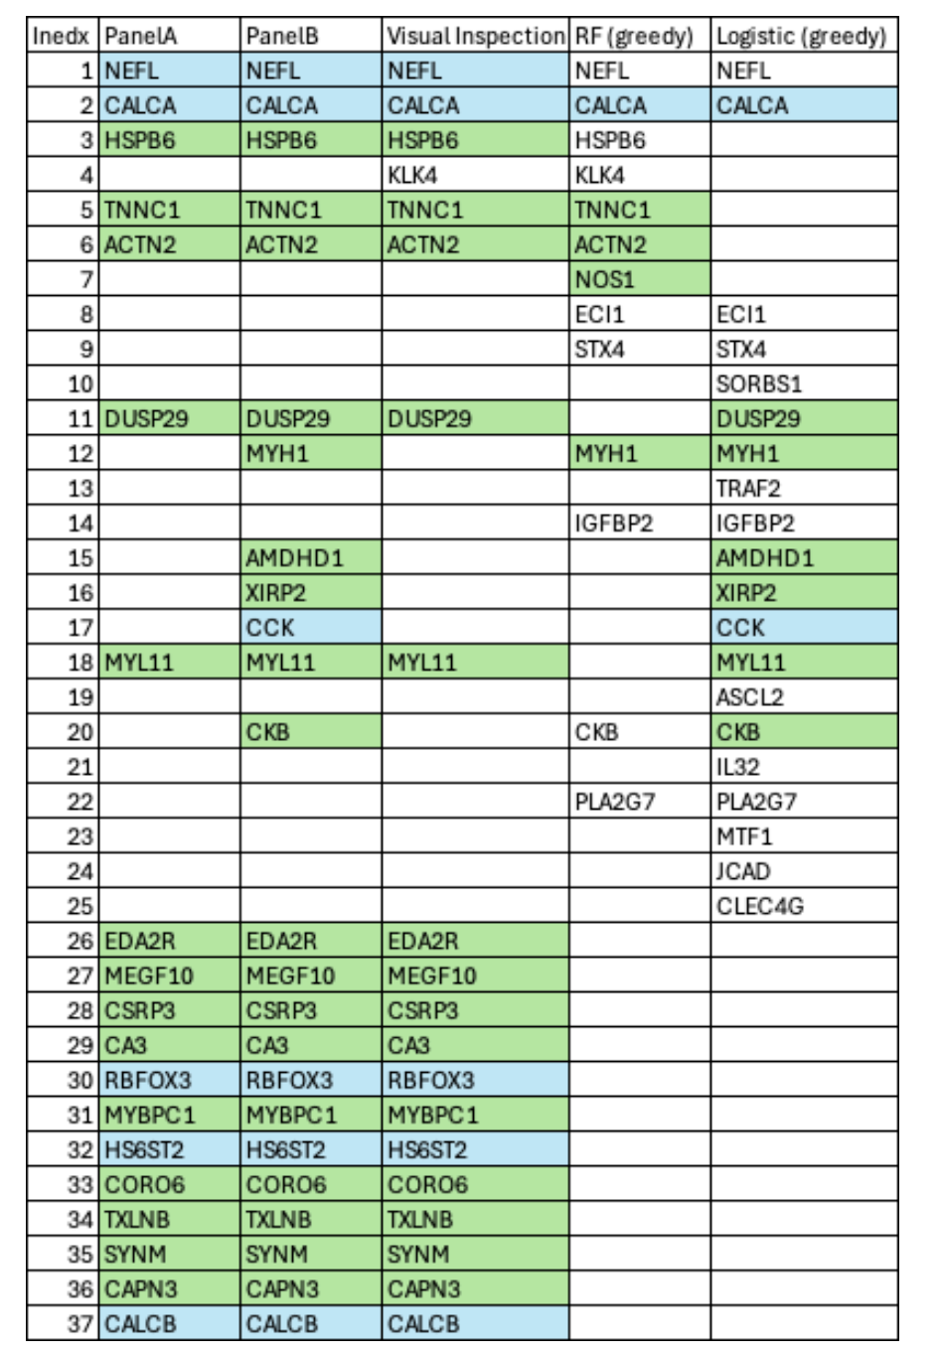
Table 3 Pannel A and Pannel B detail

Slide 4
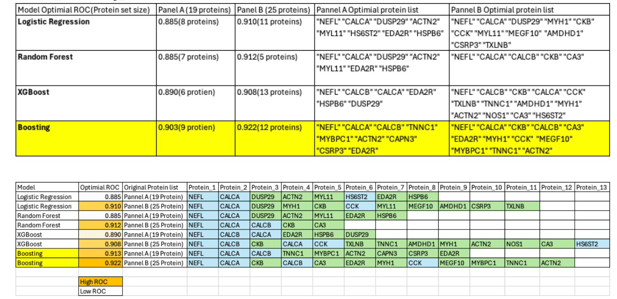
Table 4 Optimial model for pannel A and Pannel B
We will update to merge them together

Slide 5
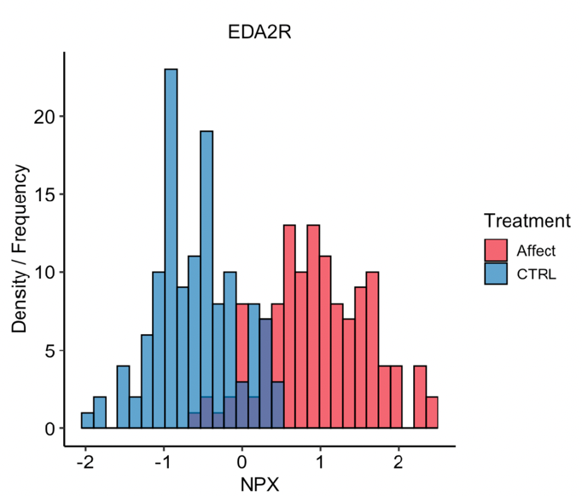
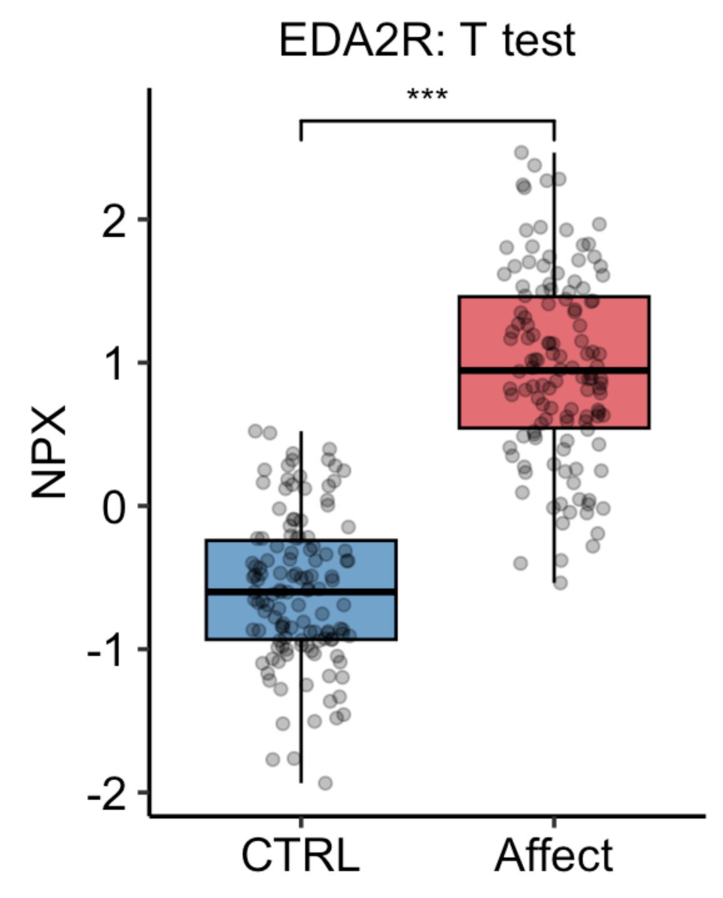
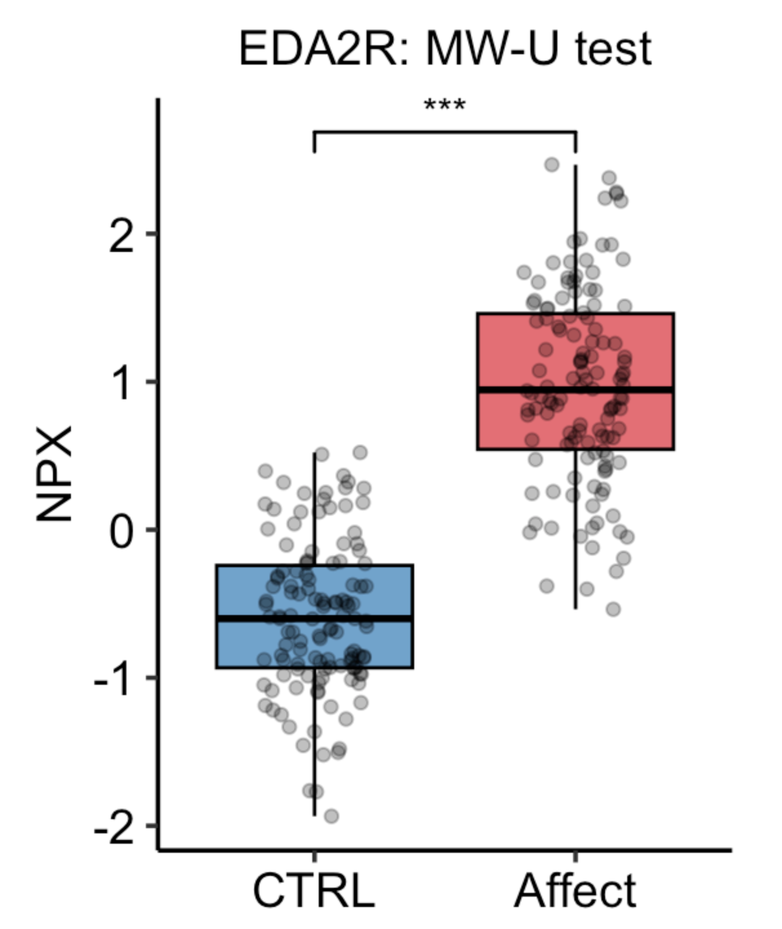
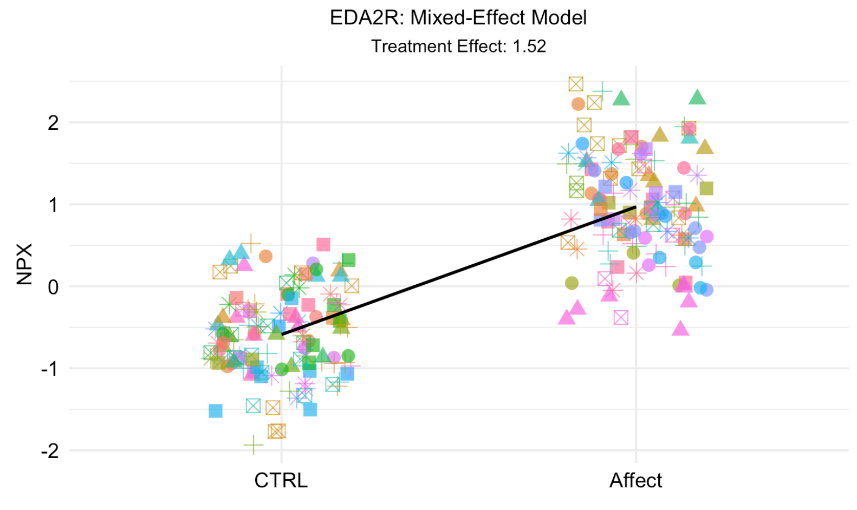
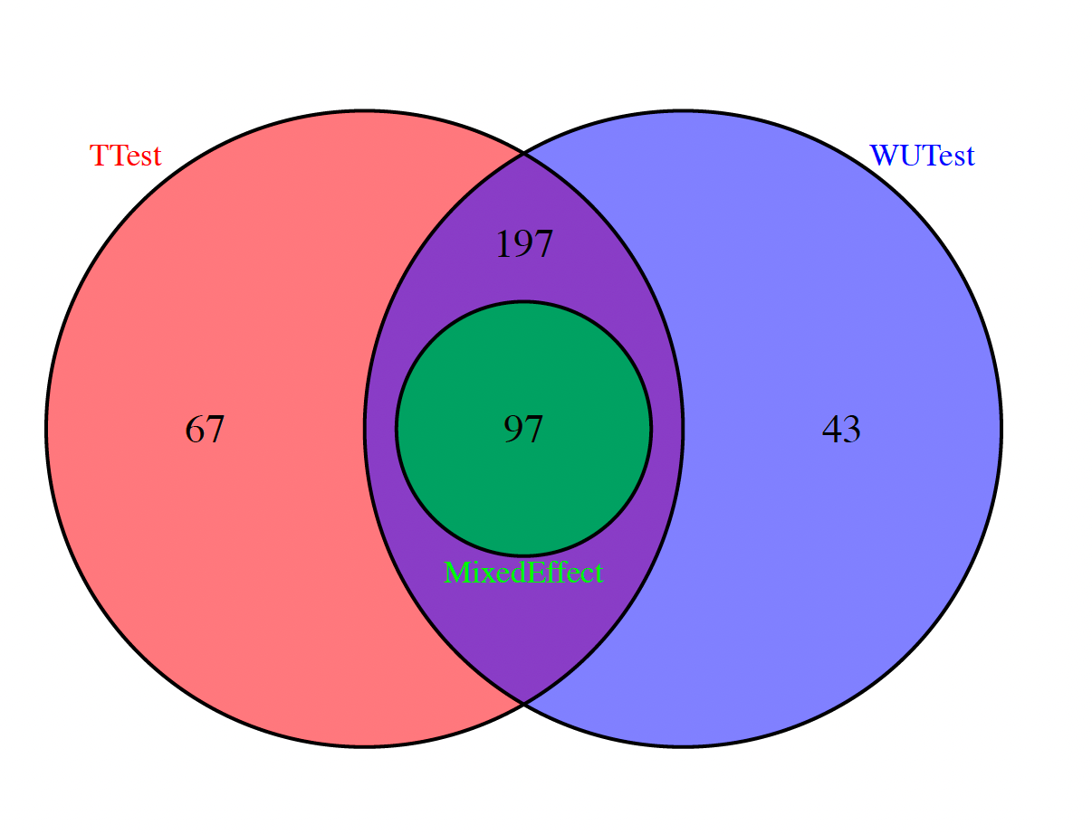
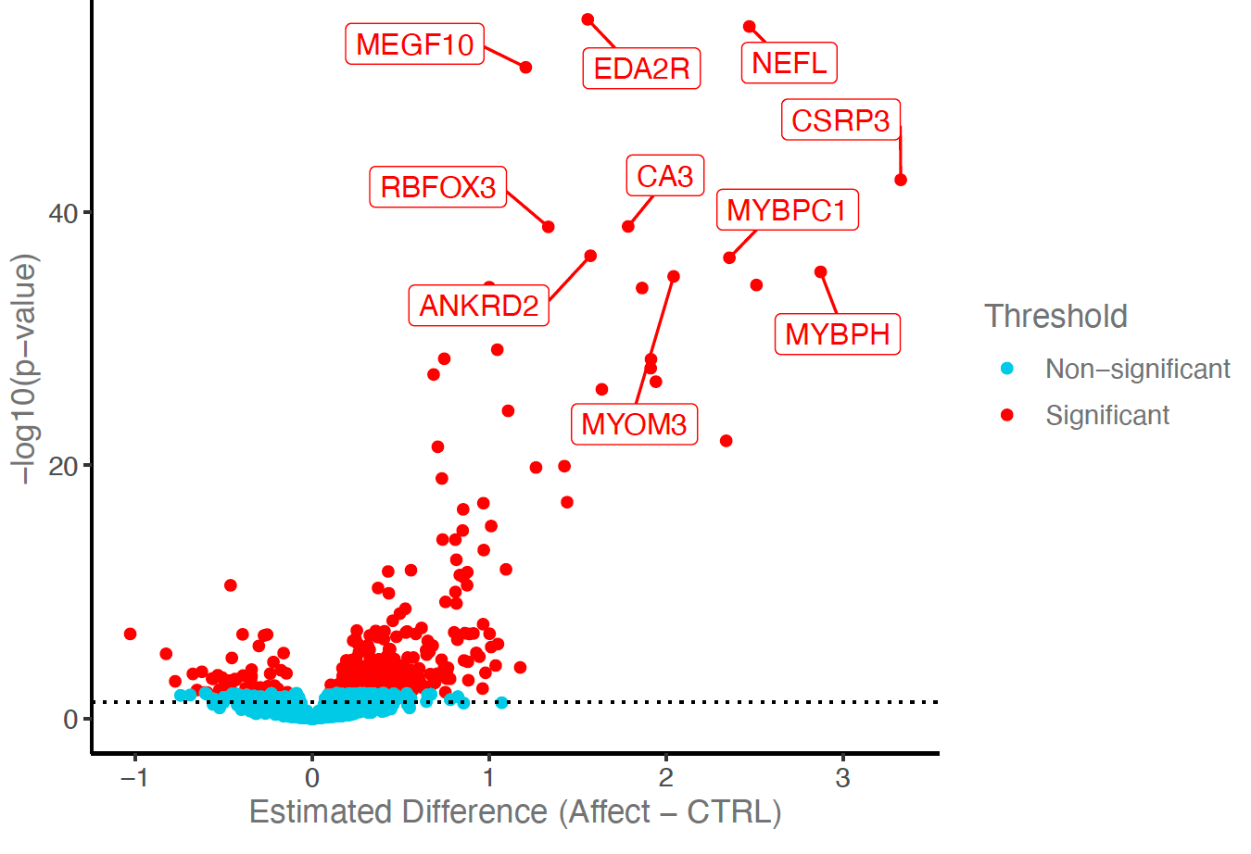
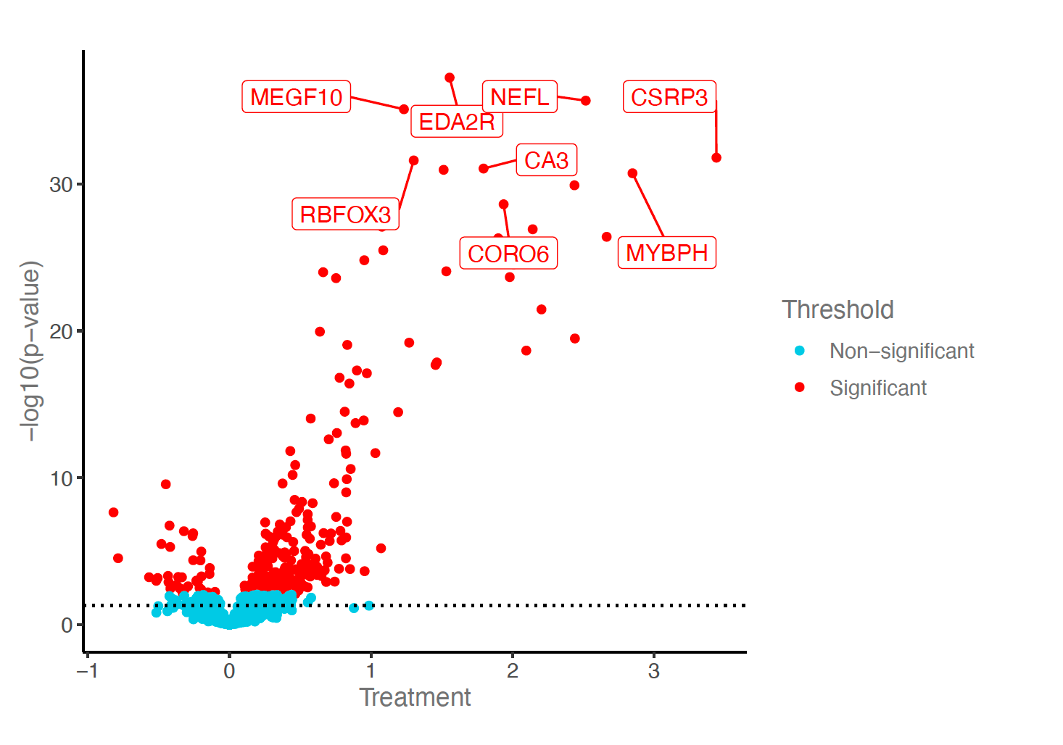
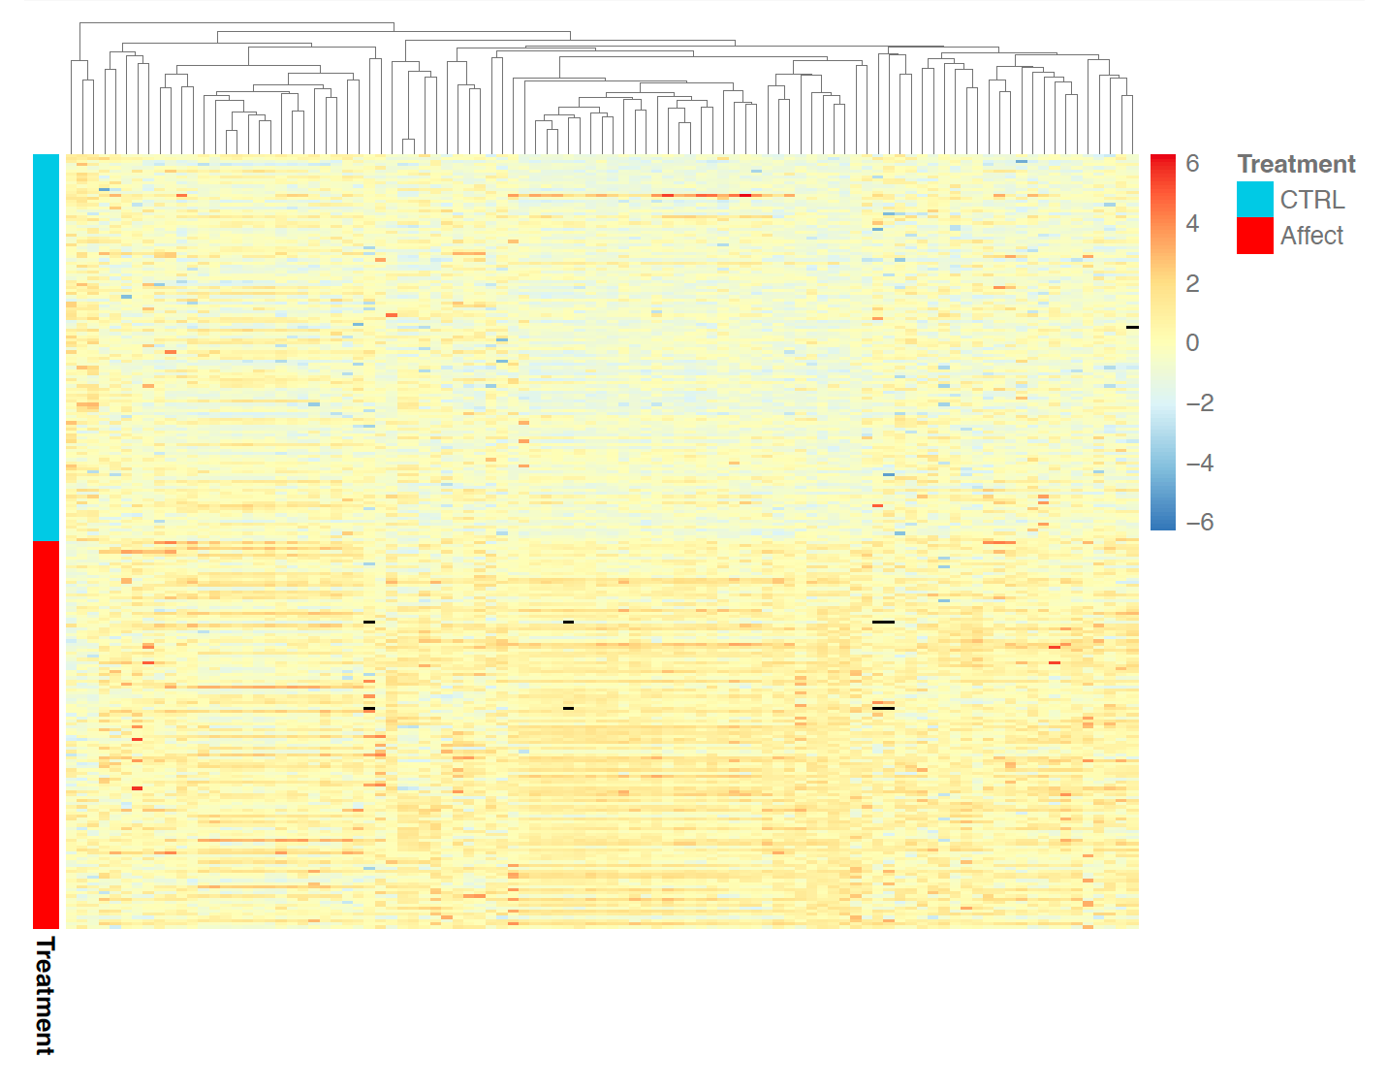

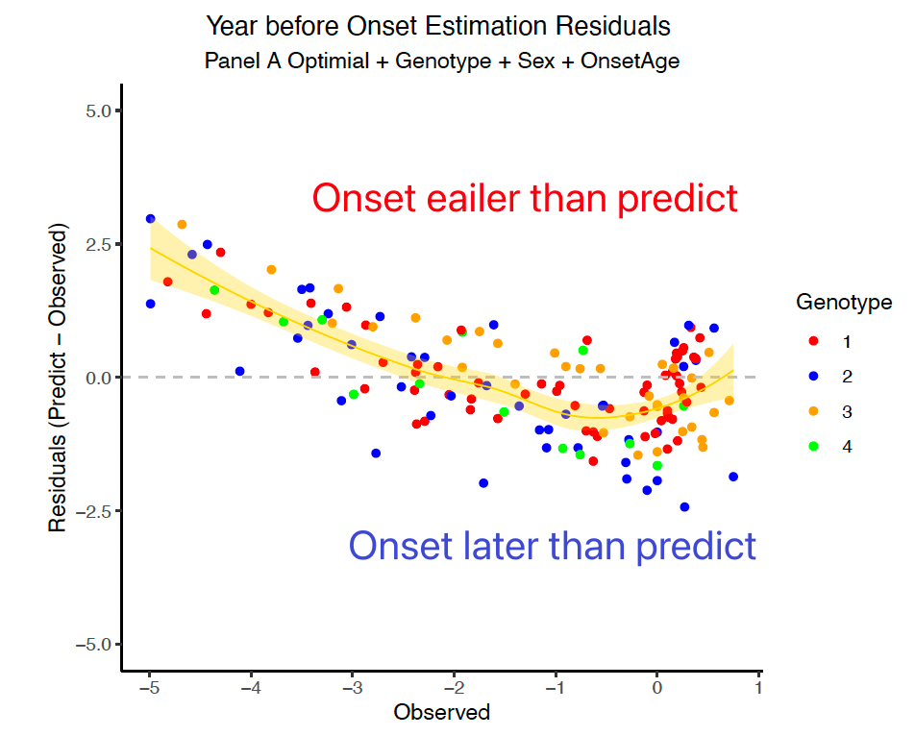
a
T test
MW-U test
Mix effect Model
b
97
protein
Whether Onset in
2 Years
Protein Selection
Optimal Protein set
Visit
covariate
Random Forest
Individual at risk
Logistic regression
XGboost
Boosting
c
Optimal Protein set
Individual known
onset
Figure 1 Blood protein components as predictors of convert of ALS.
a) Differential Protein selection
b) Classification model selection
c) Prediction disease age model

Slide 6
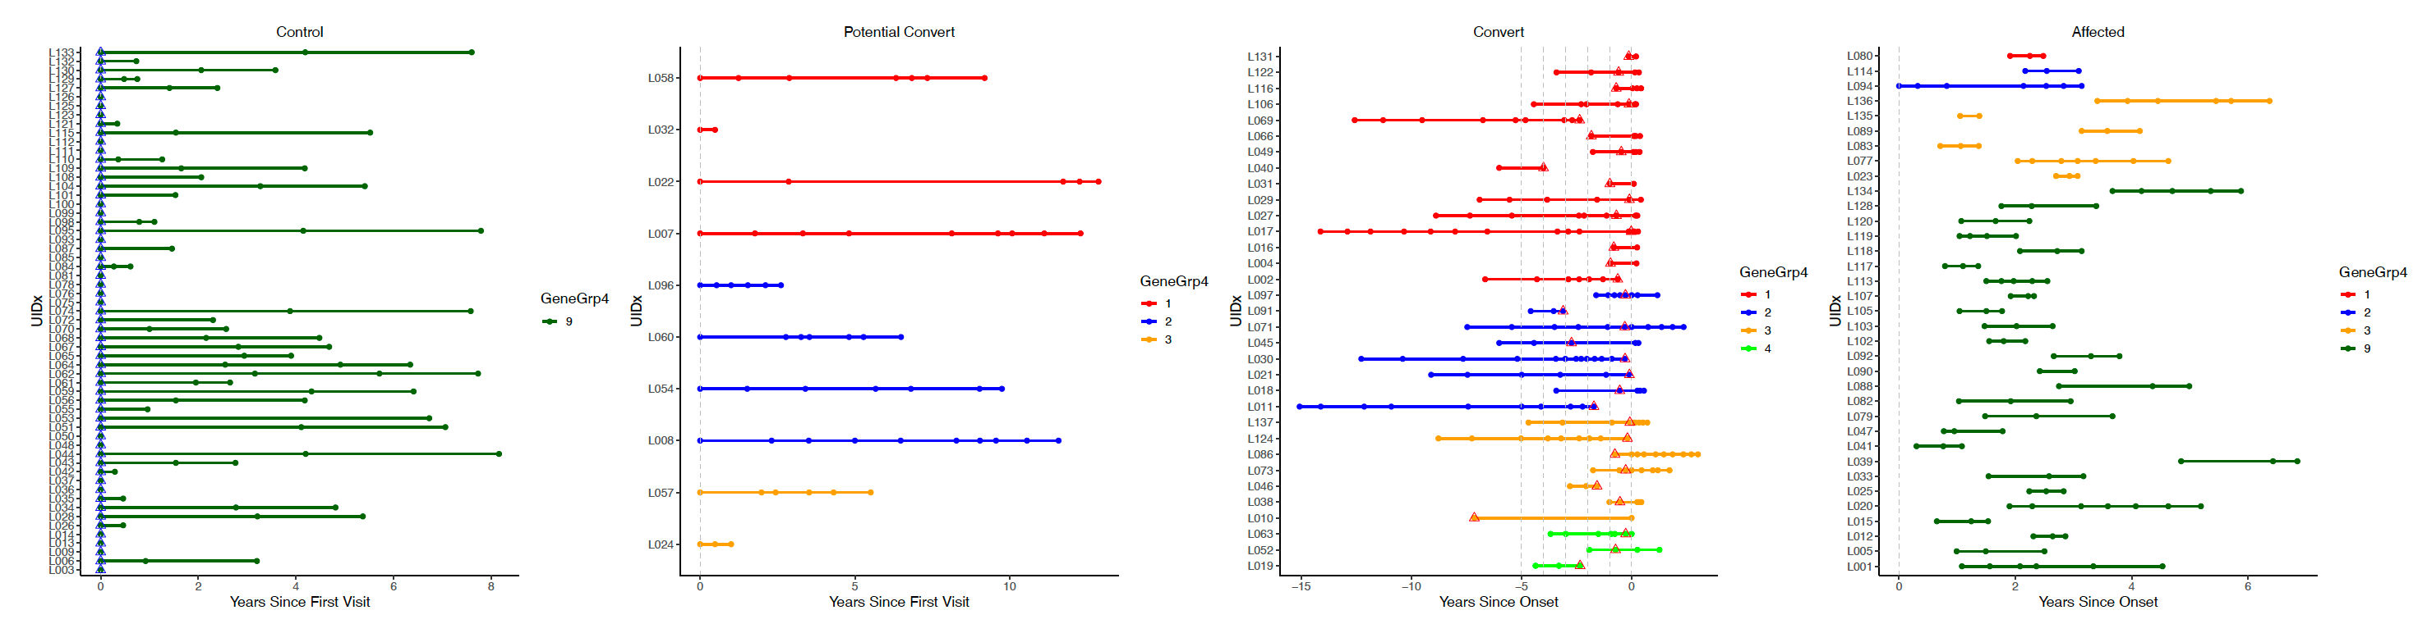
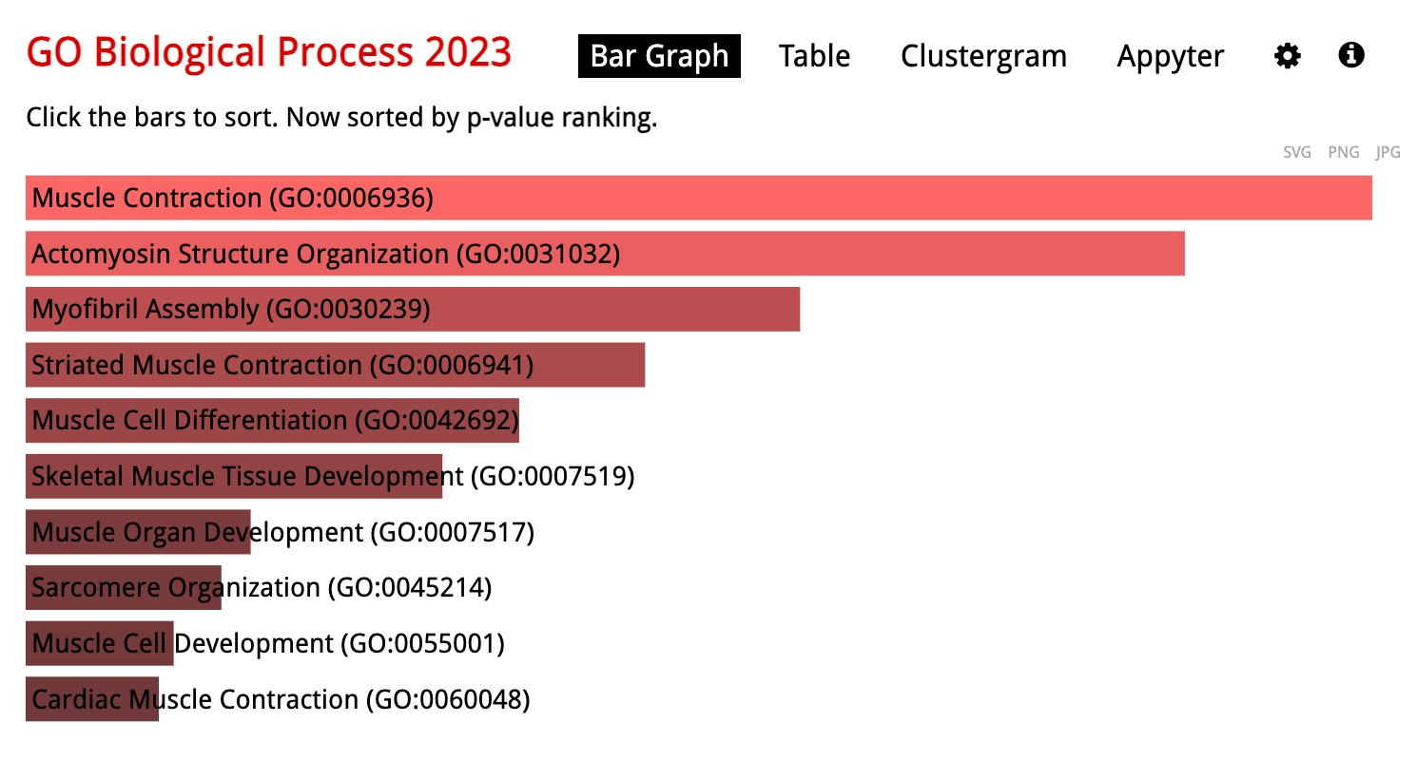
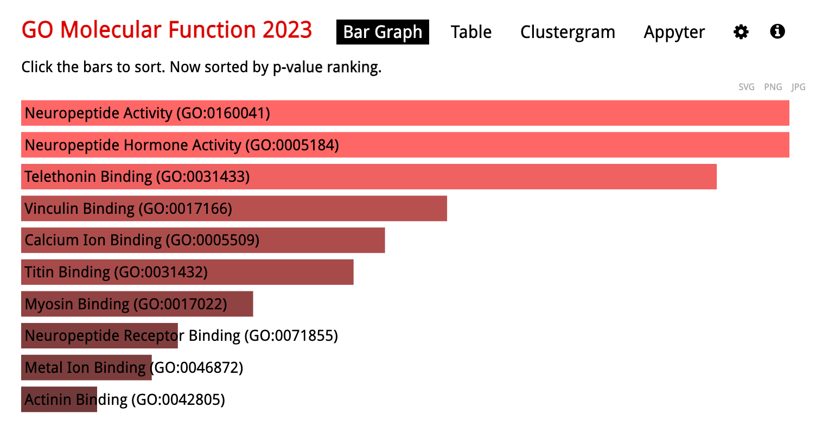
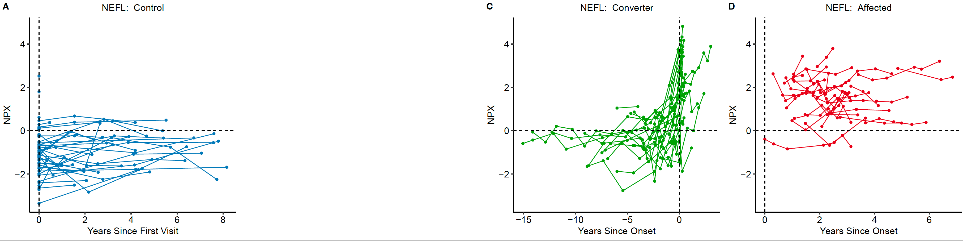
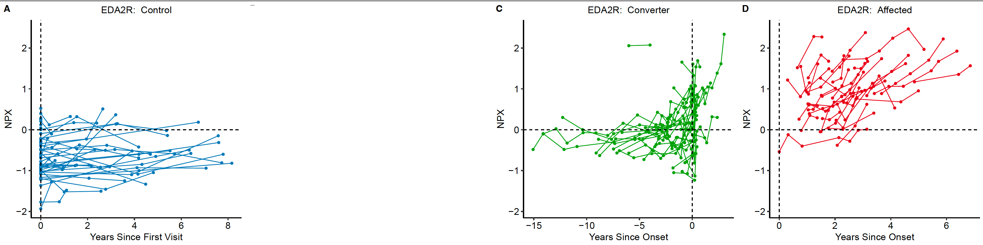
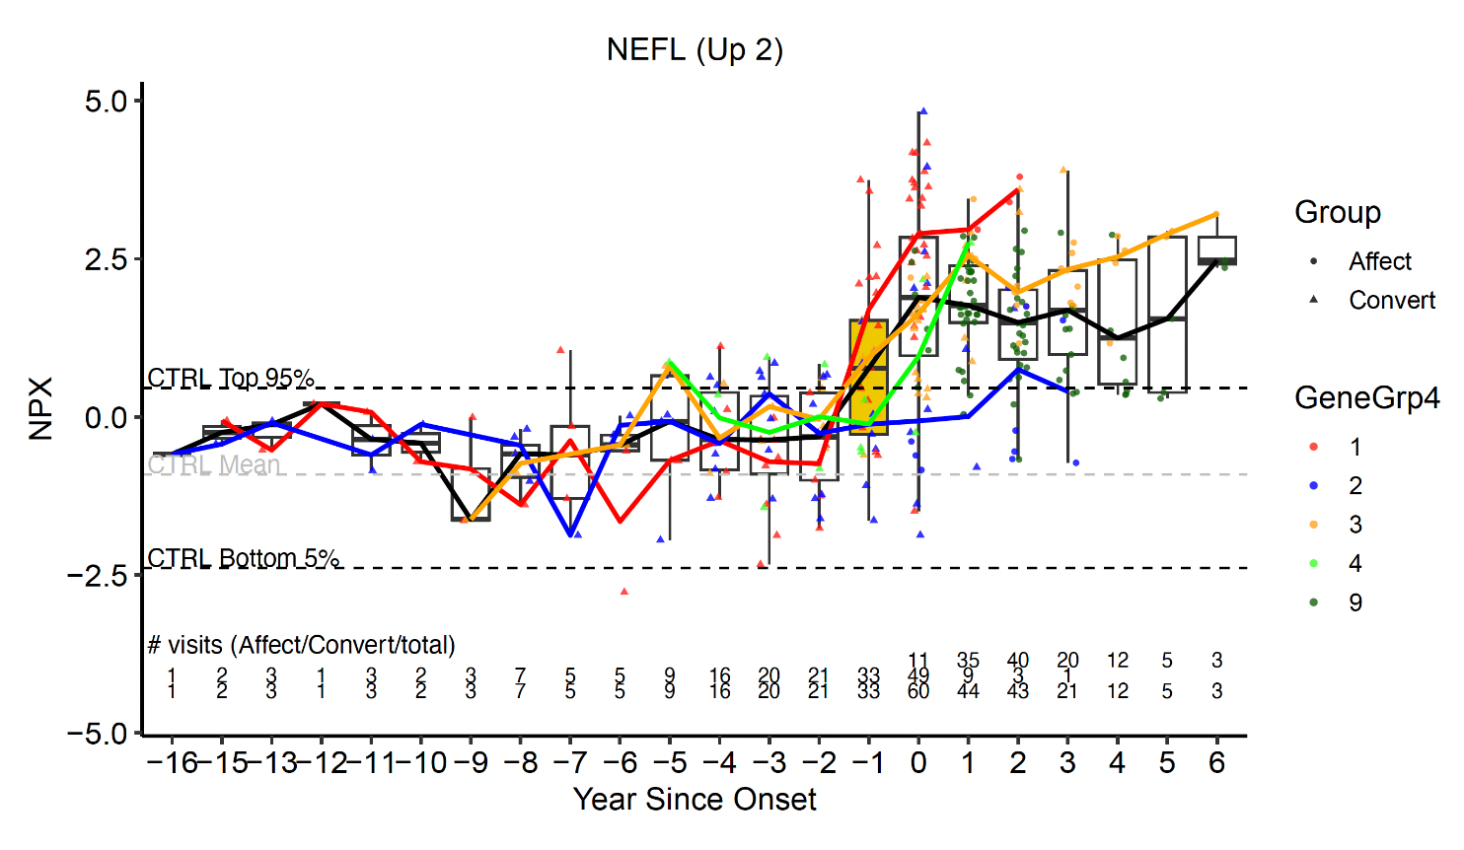
a
b
c
d
e
f
Figure 2 Description plot for protein
Visit information
Up regulate 94 protein set enrichment in GOBP
Up regulate 94 protein set enrichment in GOMF
NEFL protein expression with time trend
EDA2R protein expression with time trend
NERL protein expression with time trend bin in boxed

Slide 7
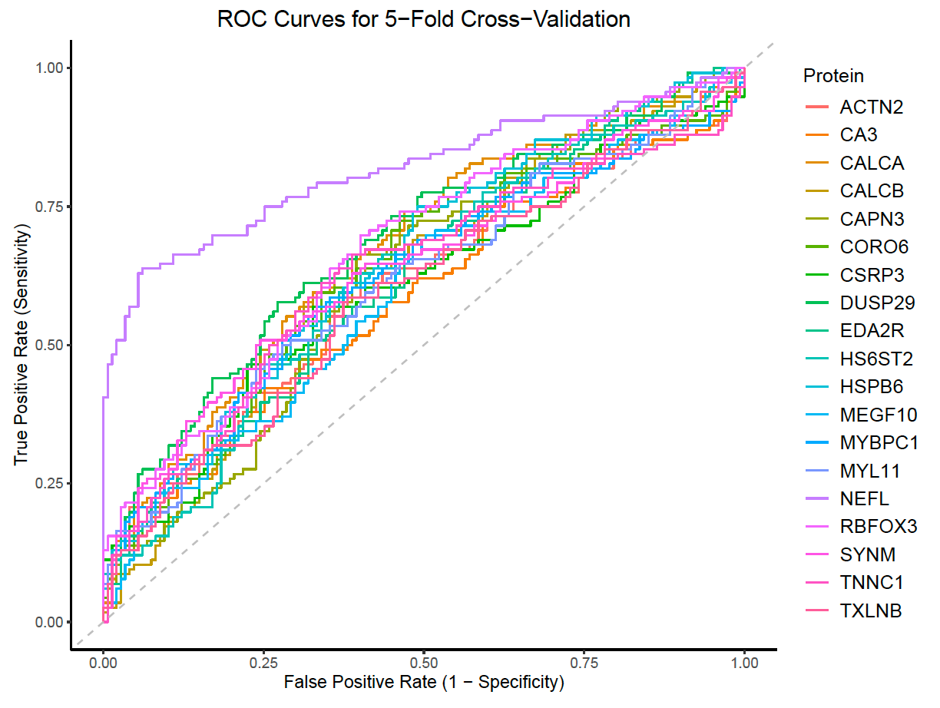
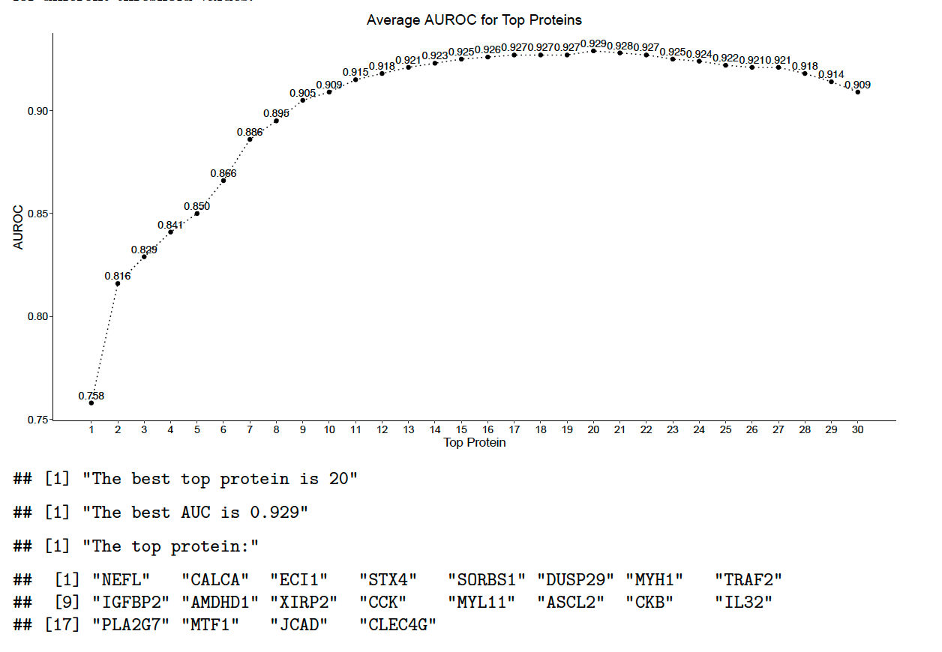
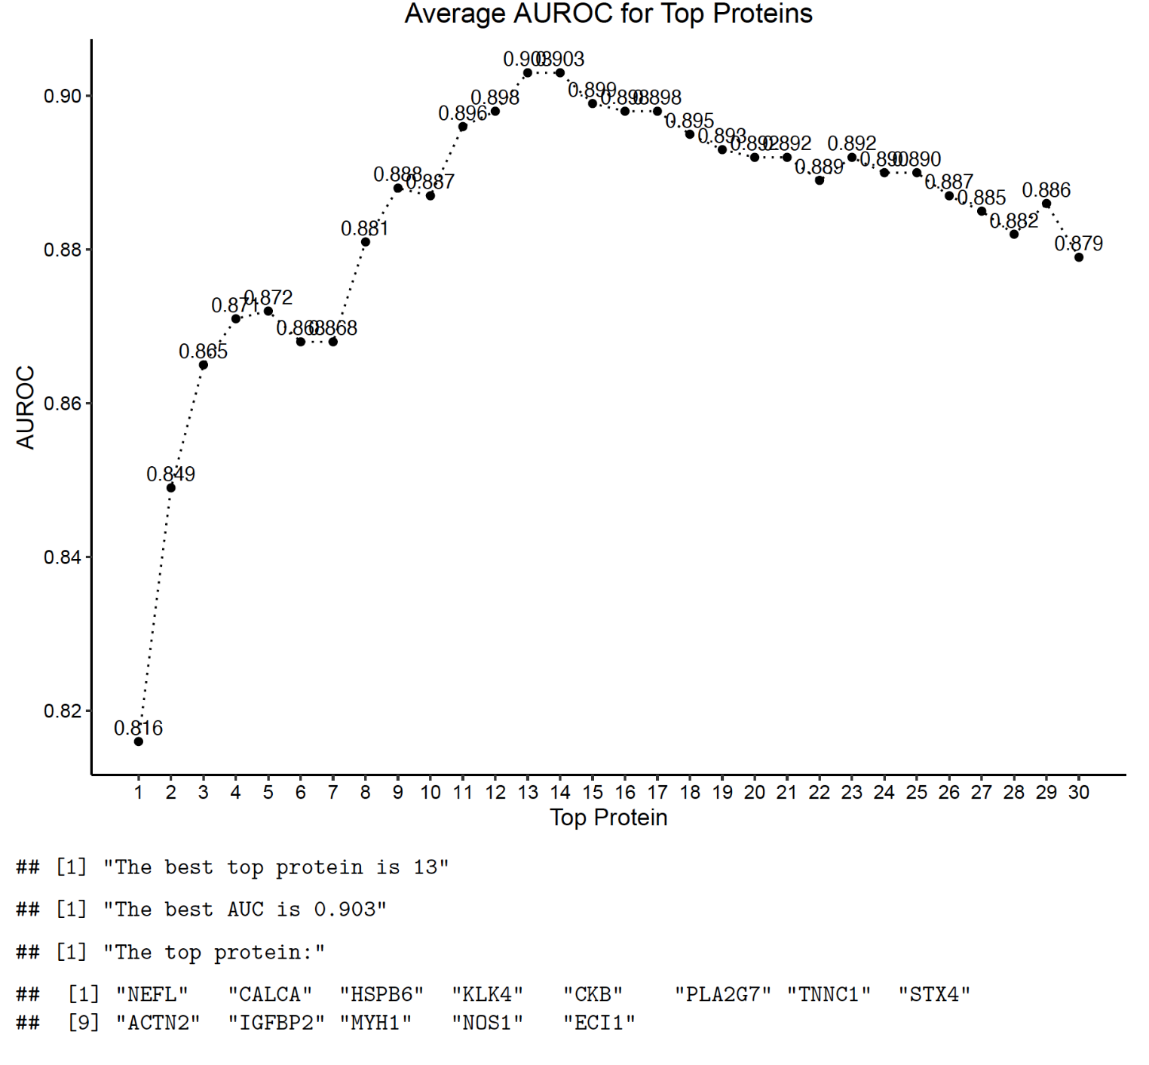
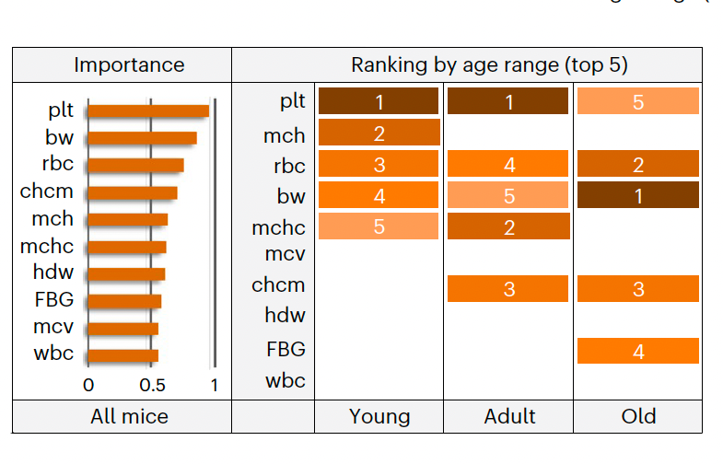
a
b
c
d
e
Figure 3 Analyzing predictive performance of ALS disease age
ROC curve for single protein predictive model
ROC curve for greedy search protein set (just demo now)
Greedy search for logistic regression
Greedy search for Random forest
Protein overlap in different method(just demo now)

Slide 8
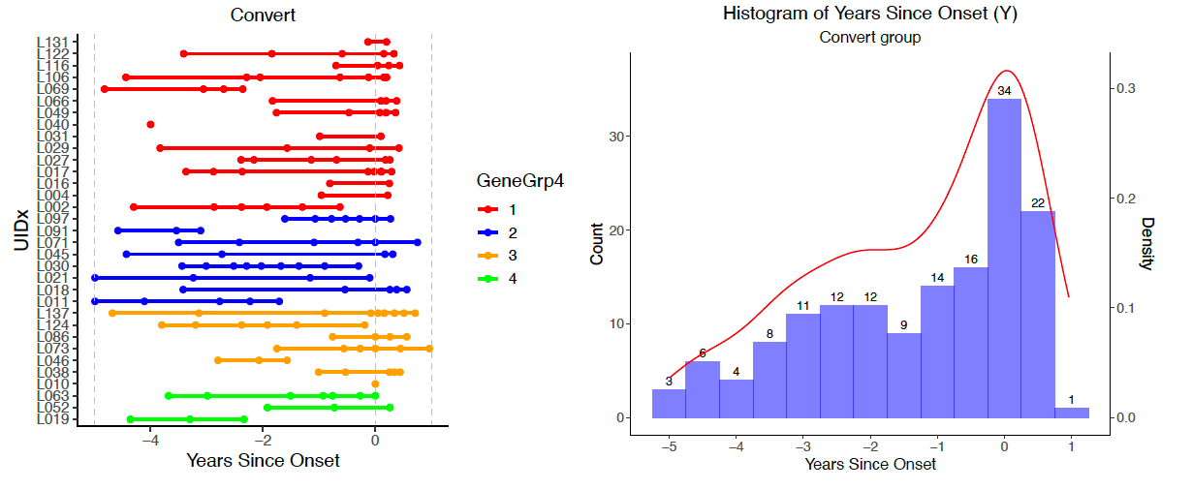
a
b
c
Figure 4 Disease age model
Visit info for disease age predcicion
Related age distribution
Estimation result from Pannel A

Slide 9
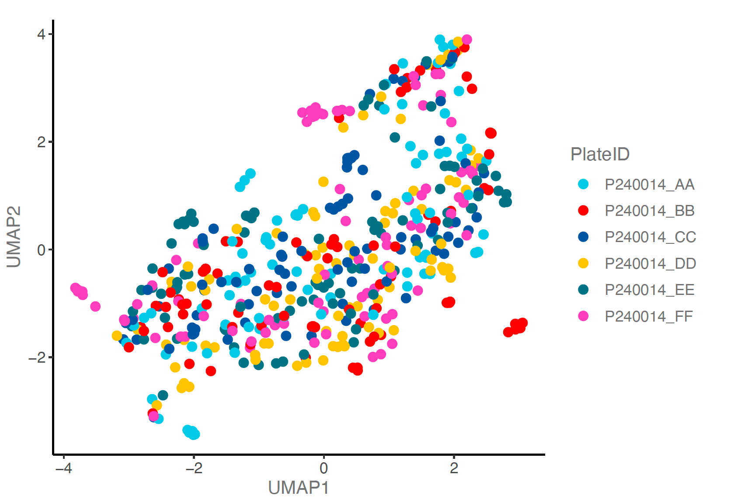
a
Supplement Figure 1
a) Protein data normalization

